Slide 1
CMPE 207 Project
SchoolBook
Team1
OmkarRege, BingShi, LamTran

Slide 2
Outline
Features and functionalities
Technologies
Server Design
Client Design
UI Design
Demo
Improvements

Slide 3
Features
User Group Access:
Students: view enrolled courses, professors and classmates, download files
Professors: view instructed courses/ enrolled students, drop students, upload/ download files
Admin: add/ remove users, add/ remove courses, enroll /drop students, upload/ download files

Slide 4
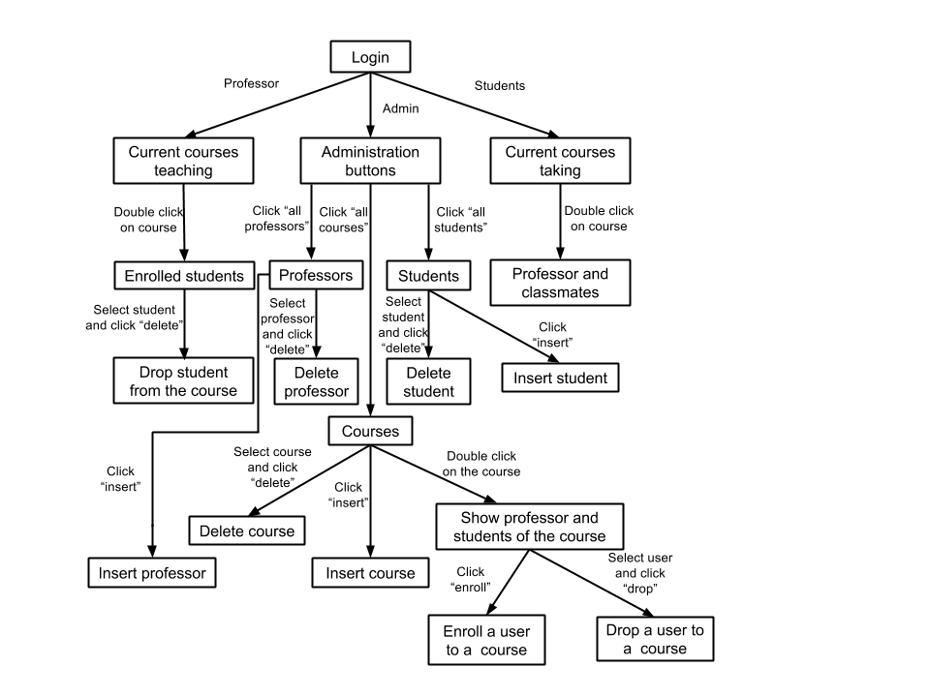
Functionalities

Slide 5




Technologies
Source Control:
PThreads, BSD Sockets, JSON-C, libmcrypt, File handling
Database:
UI: Java Swing, Java JNI

Slide 6


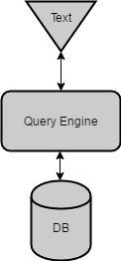
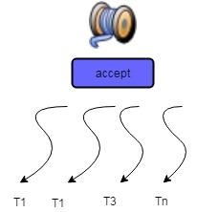
Server Design/Features (1)
ENCRYPTION | JSON FORMAT | DYNAMIC QUERY | THREADING

Slide 7
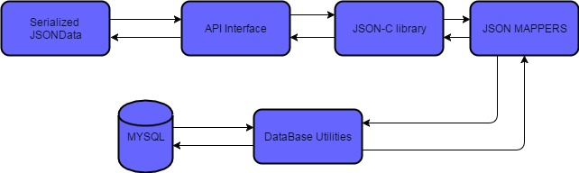
Server Design/Features (2)
Network Socket Layer Data Mapping
AES-128
Char
JSON
QUERY
Struct

Slide 8
Server Design/Features (3)
encryption.h/encryption.c (MCRYPT AES-128)
int encrypt(void* buffer, int buffer_len, char* IV, char* key, int key_len);
int decrypt(void* buffer, int buffer_len, char* IV, char* key, int key_len);
mappers.h/mappers.c (JSON Schema.h)
char* mapResutToJsonString(RESULT *res, TABLE_NAME name);
char* sendErrorJson(char* message);

Slide 9
Server Design/Features (3)
dbutil.h/dbutil.c (A Generic Query Builder)
void writeTo(char *name, void *userdata);
RESULT readFrom(char *name, FILTER filter[],int filterSize);
char* deleteFrom(char *name, FILTER filter[], int filterSize);
void updateTable(TABLE_NAME name, FILTER setterValues[], int setterSize,FILTER filter[], int filterSize);

Slide 10
Client
Communication between C client and Java GUI
GUI design

Slide 11
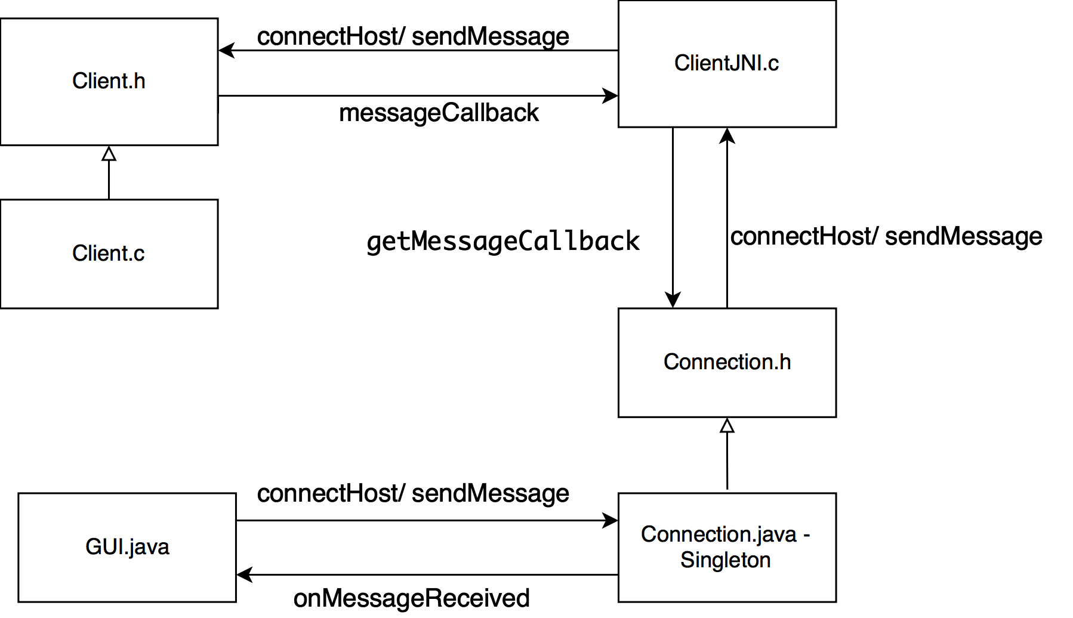
Communication between C and Java

Slide 12
Client.h - Client.c
void connectHost(const char *host, const char *service, const void (*onMessageReceive)(char const *));
int sendMessage(int s, char *message);

Slide 13
Connection.java
public interface OnMessageReceivedListener { void onMessageReceived(String message); }
public static void setListener (OnMessageReceivedListener listener)
public void getMessageCallback(String message)
static { System.loadLibrary("clientJNI"); }
public native void connectHost();
public native void sendMessage(String st);

Slide 14
ClientJNI.c
static void getMessageCallback(JNIEnv * env, jobject o, char * message) { midStr = (*env)->GetMethodID(env, (*env)->GetObjectClass(env, o), "getMessageCallback", sigStr); jstring string = (*env)->NewStringUTF(env, message); (*env)->CallVoidMethod(env, o, midStr, string); } static void getMessageFromClient(const char * mess) { getMessageCallback(smEnv, smObject, mess); }

Slide 15
ClientJNI.c
JNIEXPORT void JNICALL Java_Connection_connectHost (JNIEnv * env, jobject jobj) { smEnv = env; smObject = jobj; void (*mess) (char *) = getMessageFromClient; connectHost("localhost", "9201", mess); } JNIEXPORT void JNICALL Java_Connection_sendMessage (JNIEnv * env, jobject jobj, jstring string) { const char *nativeString = (*env)->GetStringUTFChars(env, string, 0); setInput(nativeString); }

Slide 16
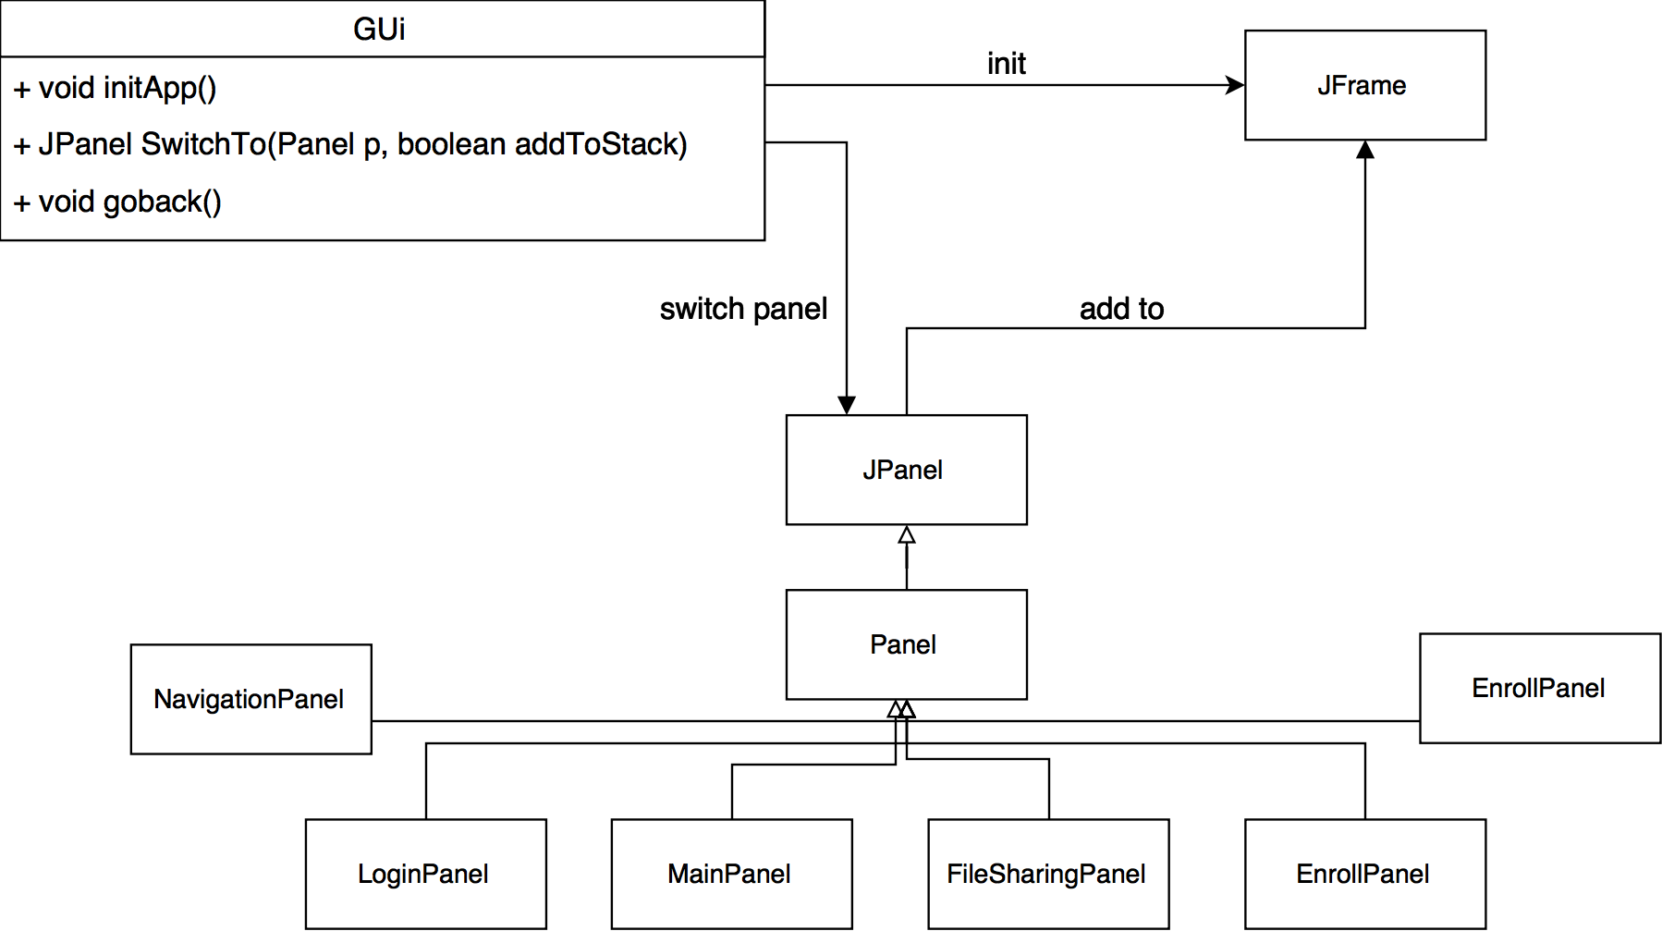
GUI Design - Java Swing

Slide 17
App Logic
Use backstack to keep track of navigation.
Set message callback and populate JSON:
Connection.setListener(message -> { try { ListPerson model1 = gson.fromJson(message, ListPerson.class); mDataList = convertPersonToModel(model1.result); updateDataSetChange(); } catch (Exception e) {
//Eat comment } });
Send message to Server: connection.sendMessage("select course current");

Slide 18
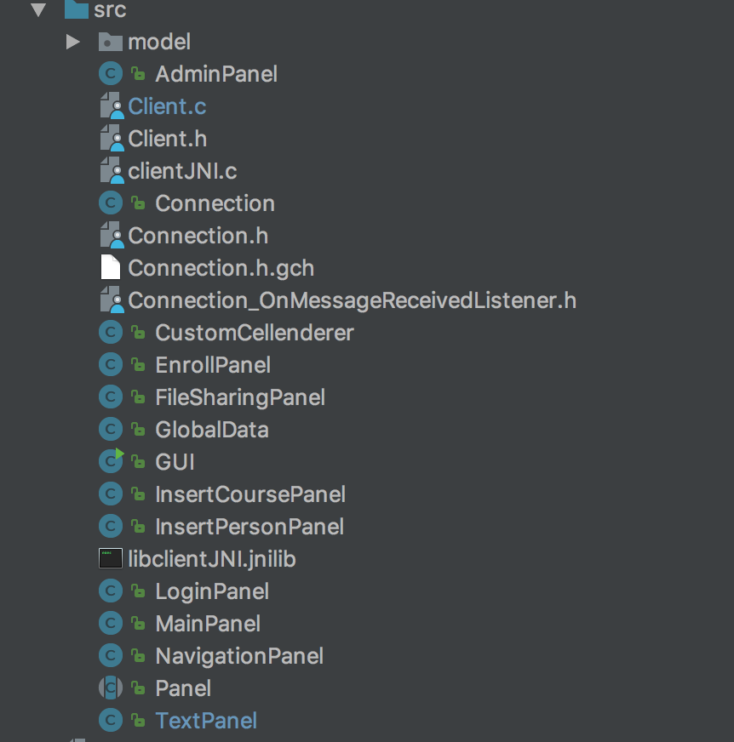
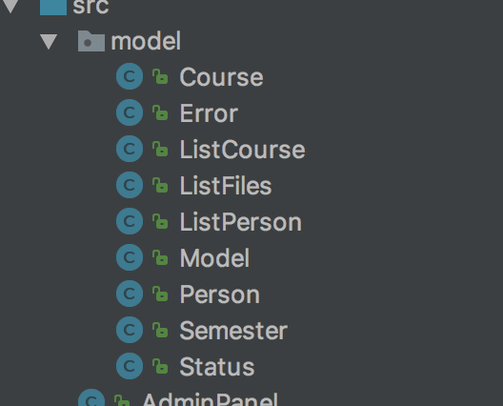

Slide 19
Demo
Login restrictions - Student/ Admin/ Prof
Error handling
Dynamic display
Navigation
Users/courses listing
Insert
File upload/download

Slide 20
Challenges
Efficiently design the server commands
Integrate different layouts
3 different system: Window, Mac, Ubuntu
Feasibility of Libraries JSON-C, mcrypt, etc
Interaction with DB (Query Builder)
Inclusion of AES-128 Block Cipher and its impact on Socket code
Efficient communicate between Server and Client using tcp
Passing data and callback from C client to Java GUI

Slide 21
Improvements
Features:
Grading System, Instant Messages
Server:
Securities Key Exchange/ hash password, More Flexible Architecture
Client:
More filter options, Concurrent Commands, Browser Support

Slide 22
Thanks!

